Slide 1
Roots of Wellness: A Community-Driven Approach to Health Communication
E. Rain Eatmon
Jasmine Dailey MPH, RD, LD, CHES

Slide 2
Agenda
Welcome and Introductions
Icebreaker
From Roots to Reach: Designing Community-Driven Focus Groups
Key Findings and Community Storytelling
Implications
Thought Tree Exercise
Wrap-Up and Resources

Slide 3
Welcome and Introductions

Slide 4
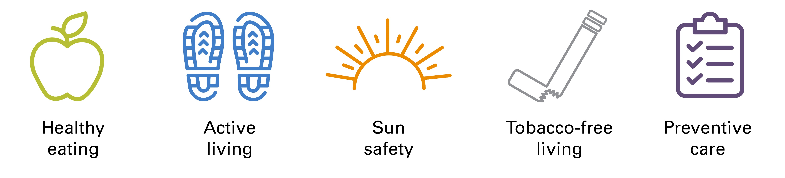
Be Well Communities™
Built on nearly 100 years of healthy community initiatives best practices, scientific literature, and direct experience in dissemination and public health practice.
Be Well Communities is MD Anderson’s place-based strategy for cancer prevention and control, working with communities to promote wellness and stop cancer before it starts.
We work collaboratively with residents and community-based organizations to implement evidence-based strategies that can reduce the risk of cancer with a focus on five key areas:
Up to half of cancer cases in the United States could be prevented through healthy lifestyle behaviors
Rechis, R, Oestman, KB, Caballero, E, Brewster, A, Walsh Jr., MT, Basen-Engquist, K, Gershenwald, J, Tektiridis, JH, Moreno, M, Williams, PA, Treiman, K, Garza, PD, Hawk, E. Be Well Communities™: mobilizing communities to promote wellness and stop cancer before it starts. Cancer Causes Control 32, 859–870 (2021). https://doi.org/10.1007/s10552-021-01439-9

Slide 5

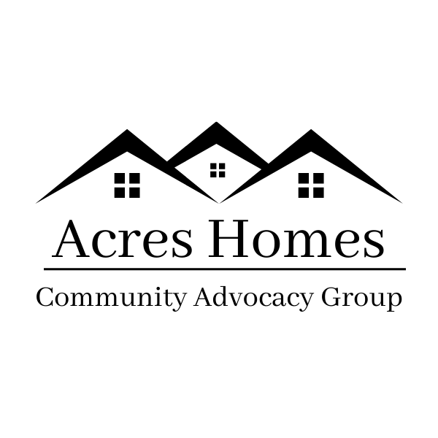












Be Well™ Acres Homes is an initiative of MD Anderson in collaboration with Harris Health System, Memorial Hermann Community Benefit Corporation, UTHealth School of Public Health, and more than 30 community organizations united together with residents of Acres Homes.
57% of the community impacted
Primary Health Outcomes Measured
Increased physical activity
Improved weight outcomes
Increased access to healthy food
Increased healthy food consumption
Increased use of sun safety behaviors (e.g., sunscreen, sun protective clothing, avoidance of sun exposure)
Decreased ultraviolet exposure
Notes:
57% impacted including FY25 metrics.

Slide 6


Acres Homes Cancer Prevention Collaboration
(U54 CA280804)
MPIs
Karen Basen-Engquist, PhD, MPH
Lorna McNeill, PhD, MPH
Ruth Rechis, PhD
Joint Collaboration
Be Well Acres Homes
The University of Texas at Austin
  Center for Health Communication
UTHealth Houston Health Science Center
Aim 1: Test interventions addressing risk factors for obesity-related cancer in the context of Be Well™ Acres Homes
Aim 2: Collaborate with residents/community organizations to foster an environment that supports research and program implementation
Aim 3: Support the careers of transdisciplinary teams of early-career researchers, focus on under-represented groups

Slide 7
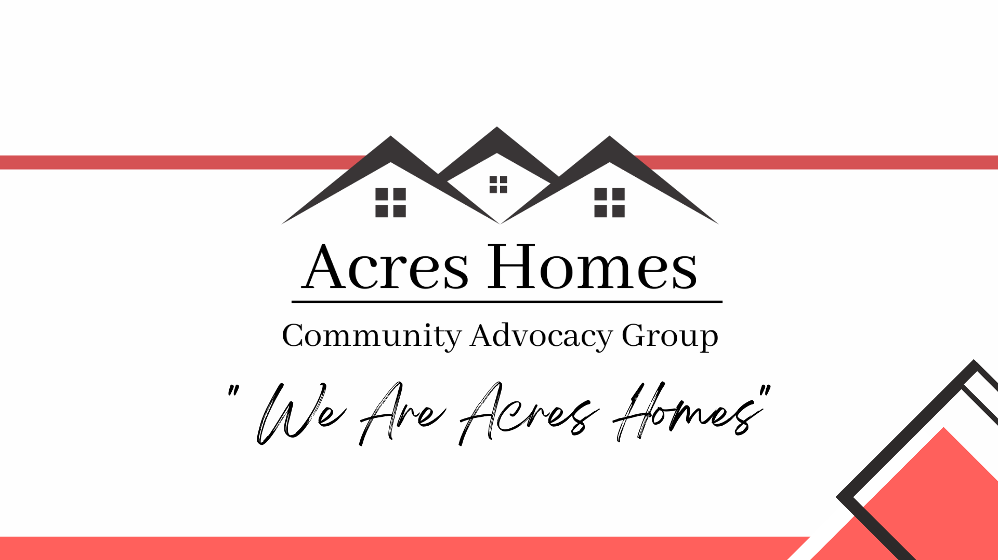
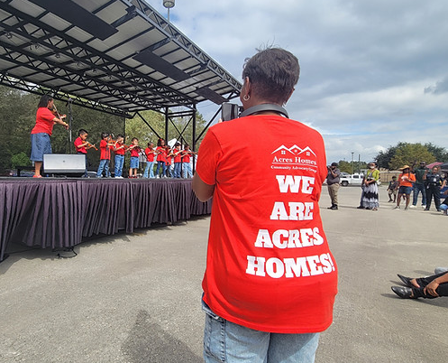
Acres Homes Community Advocacy Group
Established in 2022
Resident-led nonprofit rooted in Acres Homes
“Works to ensure that every resident is Healthy and Heard”
Worked with the Acres Homes CPC and Be Well Acres Homes team to co-design a focus group model that centered on community and accessibility.

Slide 8
Ice Breaker

Slide 9
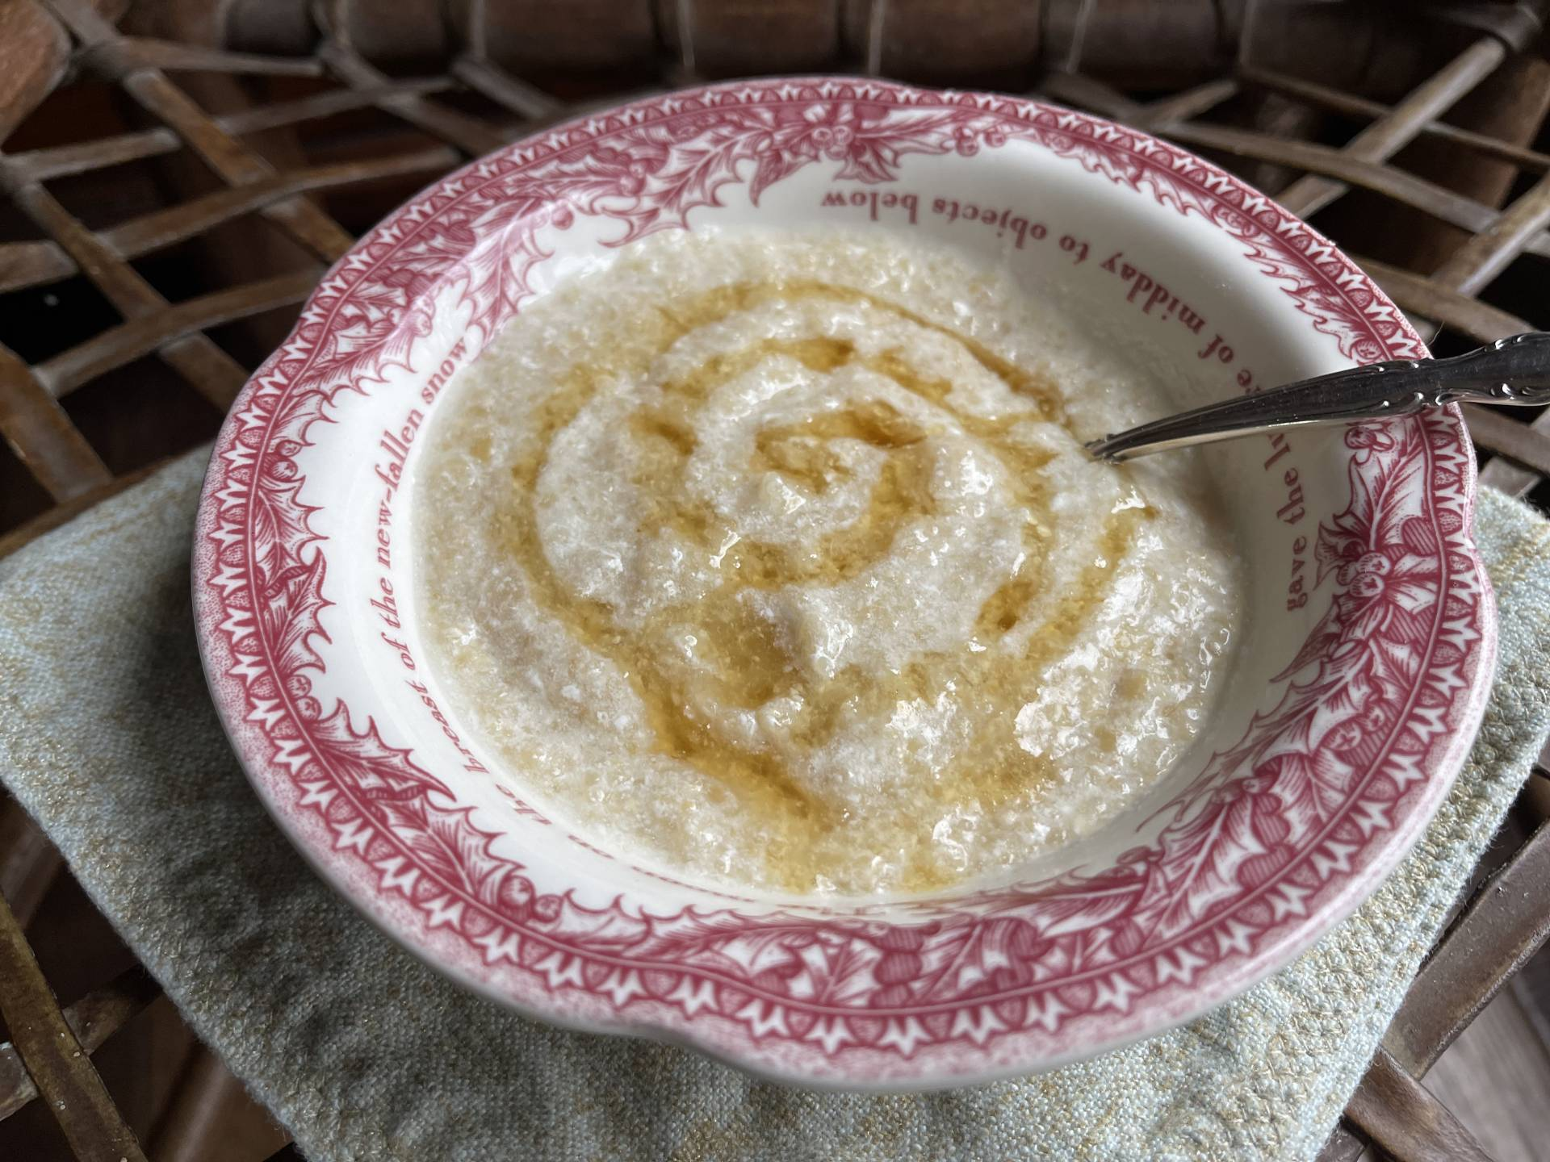


Ice Breaker
Please introduce yourself and share a moment of when food brought joy and made you feel good.

Slide 10
From Roots to Reach: Designing Community-Driven Focus Groups

Slide 11

From Roots to Reach: Designing Community-Driven Focus Groups
Thought Tree Model
Used to plan modes of engagement and connect people with places in their community for ease of access
Allowed us to identify trusted voices to help share focus groups and gain insight from untapped voices

Slide 12
From Roots to Reach: Designing Community-Driven Focus Groups
Why Focus Groups?
Storytelling
Two-Way Dialogue
Autonomy
Notes:
Storytelling: provided ways to humanize specific data points
Two-Way Dialogue: verified/identified gaps in information sharing across generations and demographics within close knit communities
Autonomy: format gave residents a sense of feeling heard and allowed them to give context where surveys would only touch on surface level information

Slide 13
From Roots to Reach: Designing Community-Driven Focus Groups
Roots of Wellness Design
Multi-Lingual Facilitation: Participant Compensation and Child Care Options
Co-Facilitators from Be Well Acres Homes team
Sessions held in/near familiar gathering spaces
Notes:
Multi Lingual Facilitation: culture translated across English and Spanish focus groups
Participant Compensation & Child Care Options
Co-Facilitators from Be Well Acres Homes Team
Sessions held in/near familiar gathering spaces

Slide 14
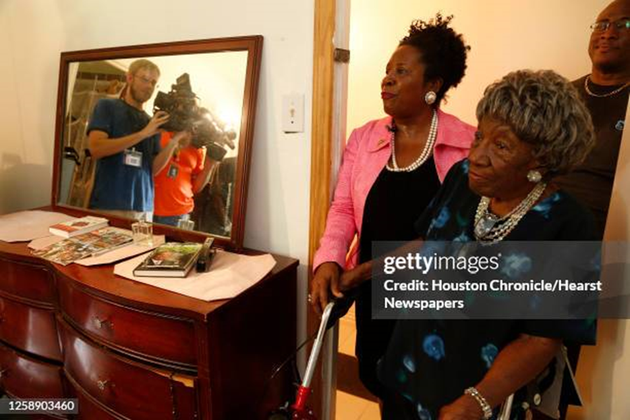
From Roots to Reach: Designing Community-Driven Focus Groups
Torchbearers Exercise
What is a torchbearer?
Who are your community’s torchbearers?
Where do people gather?
Notes:
(translators with some or loose connection to community made conversations richer)

Slide 15
Key Findings and Community Storytelling

Slide 16
Key Findings
Torchbearers/trusted voices are vital to sharing information
Most residents have a basic understanding of science-based nutrition and are eager to learn more
Pre-conceived ideas around SNAP/WIC prevent most eligible members from registering; the same can be said for food distributions in the neighborhood

Slide 17
Community Storytelling
“When I say you have to win the confidence of the other people, you have to make them be believing what you’re saying. Because we’re told a lot of things that yet we never get a chance to experience because we get---I hear that it’s gonna happen, but I’ve never seen it.”

Slide 18
Community Storytelling
“A lot of people, I just feel like some have been to the point where they got denied, and they just don't try no more. They just don't try no more. Then we have some that just don't. "Oh, no, I don't want food stamps. I don't want this. I'm not getting—" most of them.”

Slide 19
Community Storytelling
“A lot of people, I just feel like some have been to the point where they got denied, and they just don't try no more. They just don't try no more. Then we have some that just don't. "Oh, no, I don't want food stamps. I don't want this. I'm not getting—" most of them.”

Slide 20
Next Steps

Slide 21
Next Steps
Translating insights into action: Using focus group findings to shape a targeted health communication campaign for Acres Homes, in collaboration with Be Well Acres Homes and the UT Center for Health Communication.
Empowering trusted voices: Partnering with community torchbearers and providing them with ready-to-share print and digital materials to spread awareness of health and wellness resources throughout the neighborhood.

Slide 22
Thought Tree Exercise

Slide 23
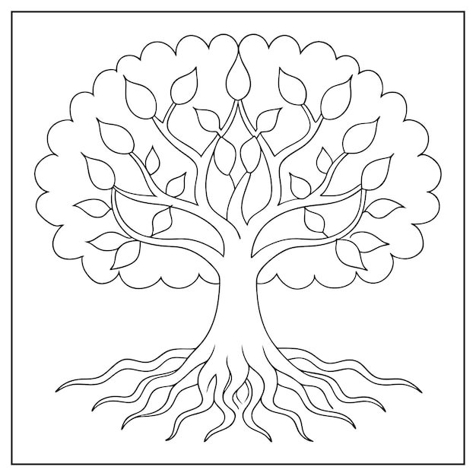
Thought Tree Exercise
Roots: Purpose and community values/barriers
Trunk: Trusted messengers
Branches: Gathering spaces
Leaves: Define the conversations
Blooms: Turning insight into action

Slide 24
Thank you!
E. Rain Eatmon
Rain@AcresHomesCAG.org
Jasmine Dailey
JCDailey@MDAnderson.org

